Slide 1
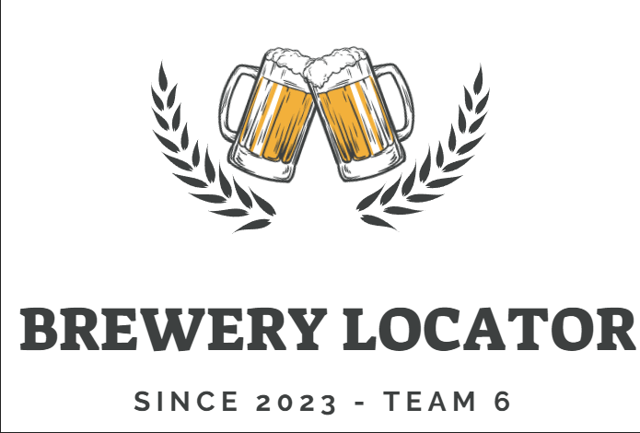
Brewery Locator and Rating Service

Slide 2
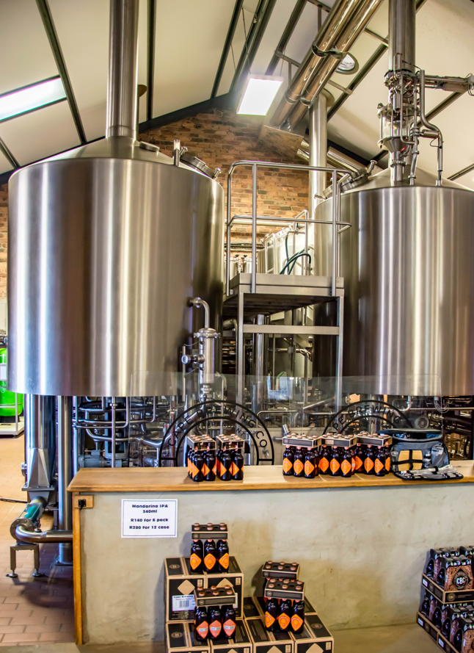
Elevator pitch
Beer craft fans has become very popular each year , users like to find a breweries with selective type of delightful beers and like to visit exploring local breweries.
There is a need on the Target audience of beer enthusiasts that wish to find a local brewery easily according to their location and preference of brewery type.
This application becomes very attractive due the fact that Beer Craft breweries have been increasing year over year and total industry has had a huge growth; Retail dollar sales of craft beer increased 21%, to $26.8 billion on 2022 U.S. beer market. The fact of having an application specialized on breweries helps users to find the right place according their beer preferences contributing to this growth.
https://www.brewersassociation.org/statistics-and-data/national-beer-stats/

Slide 3
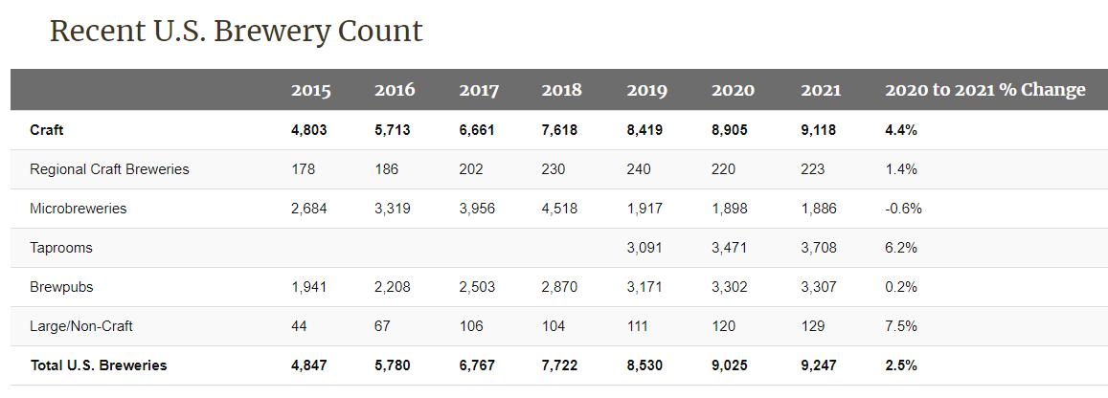
Elevator pitch

Slide 4
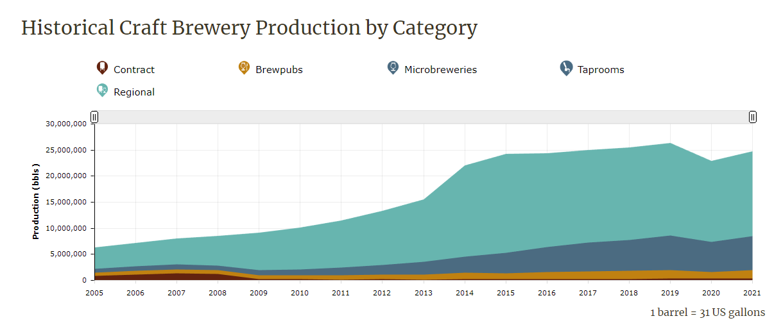
Elevator pitch

Slide 5
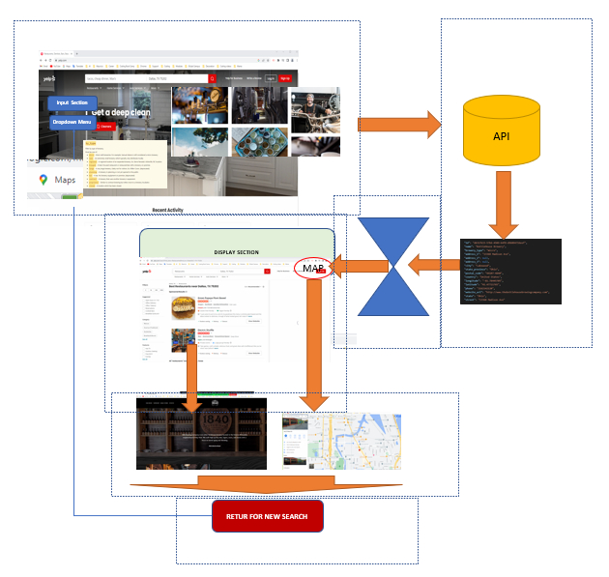
Concept
Description
The purpose of this application is to create a website that provides the user (consumer of craft beers) an easy way to locate breweries according to rating and location using a zip code. Application pulls data from different breweries options, location and rating from other customers; this helps user interested in breweries to quickly find multiple options based on their type of beer, location and select their rating.
Application uses external API to collect and display the Breweries data.
Motivation for development?
Approach to this market with huge potential using API brewery database, Google maps information. Using HTML, CSS, JavaScript, jQuery and Style framework.

Slide 6
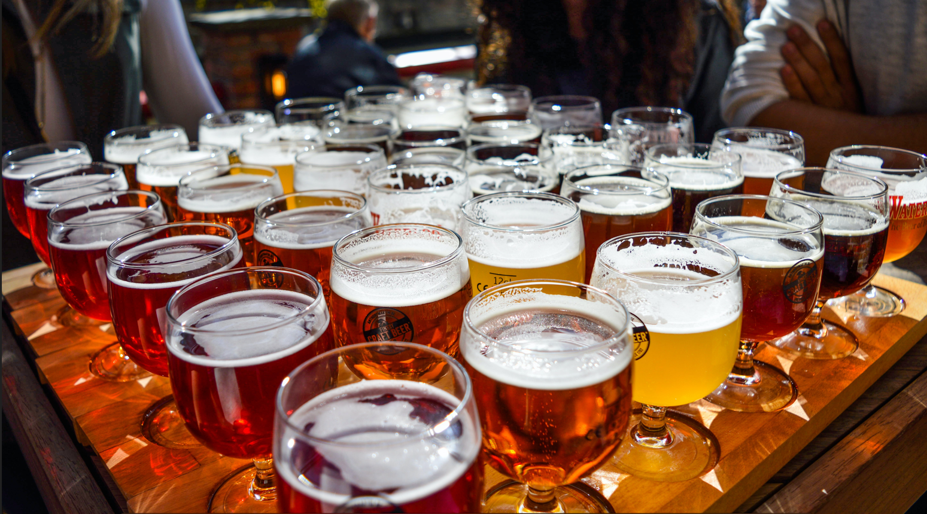
Concept
User story
- As Beer craft enthusiast (user), I would like to identify where are the Breweries closer, according to my location.
- I would like to select the Brewery according the type of Brewery like Micro, Nano, Regional , Bar etc.
I would like to be able to see the customer rating for each brewery and search according this rating as an option.
- Repeat search using different criteria: Type of Brewery, Ratings or Zip location.

Slide 7
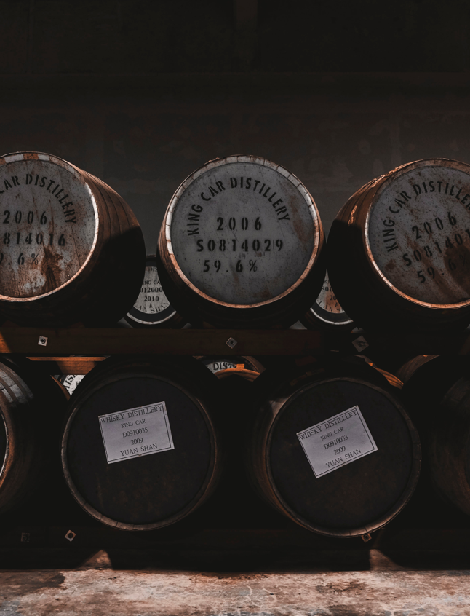
Process
Technologies used
Application was created using the following coding languages, search and style framework.
​- HTML
- JavaScript
- CSS
- jQuery
- Style-API Materialize CSS https://materializecss.com/
APIs
​- Open Brewery DB https://www.openbrewerydb.org/
(Open Brewery DB is a free dataset and API with public information on breweries, cideries & brewpubs)
- Google Maps: https://developers.google.com/maps/
- Maps JavaScript API : https://developers.google.com/maps/documentation/javascript/places

Slide 8
Process
Breakdown of tasks and roles
- HTML, CSS, jQuery and Style Framework. Mauricio Gomez
- JavaScript, jQuery, HTML functions. Reno Raju
- JavaScript, API. Anson Hendrick
Challenges
- Original API selected was Yelp, did not work correctly with our application
- Google Maps API interpretation
- Time limitation to include additional ideas for the application
Successes
- Successful integration of Multiple API and Webpage Application design
- Great team collaboration and communication
- Flow concept development and implementation accordingly
- Good recover from unexpected challenge with Yelp API.

Slide 9
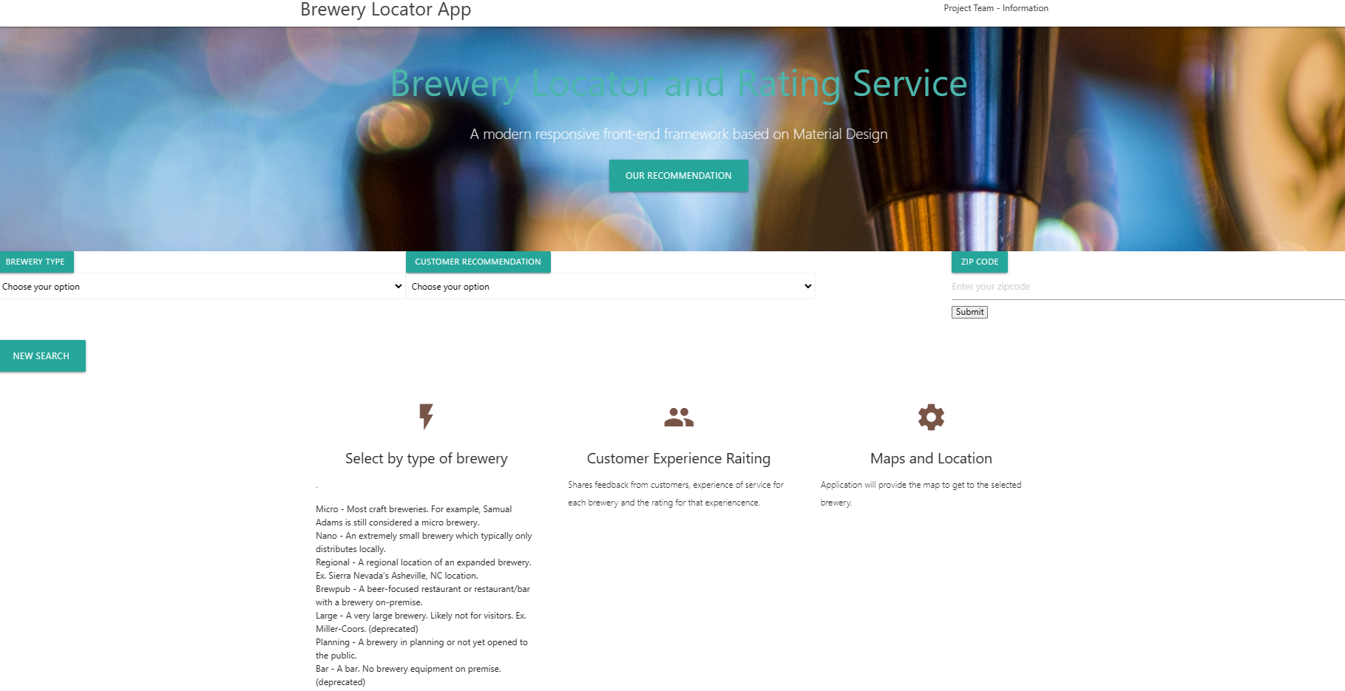
Demo
Demo: Link to the WEB deployed application and ready to run from the browser:
https://mauriciogb1.github.io/Project-1-Brewery-locator-and-rating-service-website-Group-6/

Slide 10
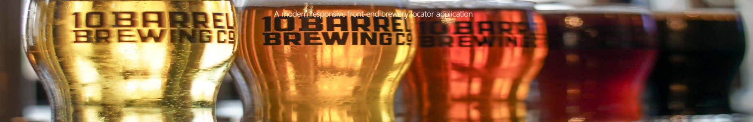
Directions for Future Development
Future Development
- Optimize data display for more user friendly and atractive look
- Include Map locator
- Links to each Brewery webpages fully connected
- Top Ten list of Breweries
- Offers that each Brewery has and recommendations for users

Slide 11
Links
Deployed
Link to the WEB Deployed Application and ready to run from the browser:
https://mauriciogb1.github.io/Project-1-Brewery-locator-and-rating-service-website-Group-6/
GitHub repo
Link to GitHub Repository:
https://github.com/MauricioGB1/Project-1-Brewery-locator-and-rating-service-website-Group-6

